Slide 1

Smart Thermostat PROPTYPE
Johnathan Picek
CPSC 46000-003
Programming Languages
Dr. Eric Chou
Lewis University
Spring 2022

Slide 2


SET COMMAND
SET keyword: target int: temperature ex: SET SLEEP 68 This usage applies the temperature to the target range. Acceptable temperatures are > SAFETY_TEMP_MIN and are < SAFETY_TEMP_MAX. Acceptable target time periods are: NOW: the current hour and next, only ALL: overwrites ALL hours in the schedule SLEEP, WAKE, AWAY, HOME – four pre-set periods with definable boundaries
SET int: temperature ex: SET 71 This usage is technically just an alias for SET NOW int: temperature

Slide 3
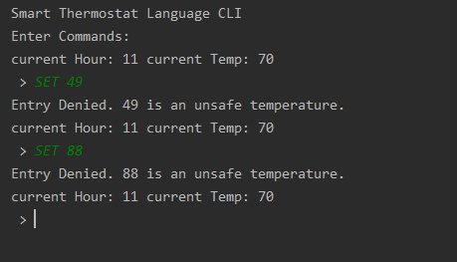
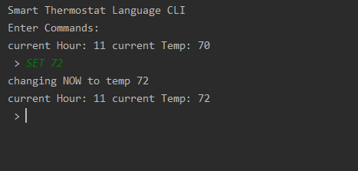
SET command
Successful Entry
Unsuccessful Entry
Outside of Safety Temp Ranges

Slide 4
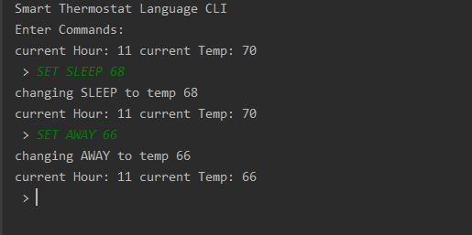
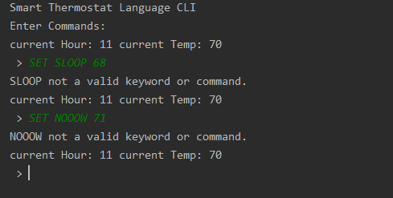
SET target command
Successful Usage
Improper Usage
Improper Target Specified

Slide 5
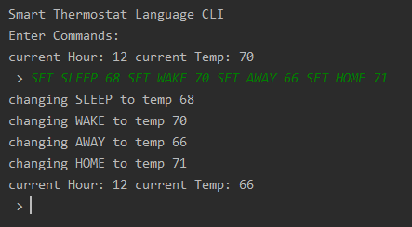
Command CHAINING
Chaining correct commands processes all of them, due to the Expression Stack implemented in STPParser.py
SET SLEEP 68 SET WAKE 70 SET AWAY 66 SET HOME 71
Note: These conditions will be the starting point used to show BOUNDARY command usage later.

Slide 6
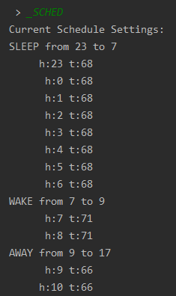
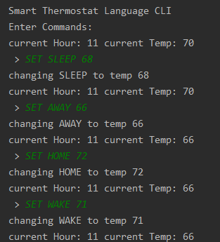
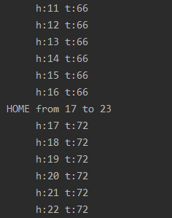
_SCHED COMMAND
_SCHED displays all schedule settings in full
The default schedule setting is 70 degrees for each hour in the day
After these SET commands
The schedule is

Slide 7
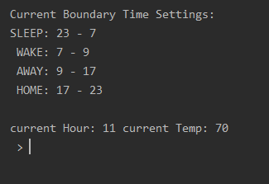
_SYSPROPS COMMAND
In addition to the schedule, the _SYSPROPS command displays the summarized changeable target boundaries
These boundaries (default 7, 9, 17, and 23) are changed through the command explained in the next slide, the BOUNDARY command.

Slide 8
BOUNDARY COMMAND
BOUNDARY int: BOUND_ID {0…3} int: HOUR ex: BOUNDARY 0 6 This usage adjusts the hour of the boundary, which is the transition between time periods. 0 is from SLEEP to WAKE 1 is from WAKE to AWAY 2 is from AWAY to HOME, and 3 is from HOME to SLEEP Assumptions: The design requires HOUR of BOUND_ID at 0 < 1 < 2 < 3, such that no crossing over may occur. BOUND_IDs 0 and 3 may not crossover the beginning or end of the day, HOURs 0 and 23, respectively.

Slide 9
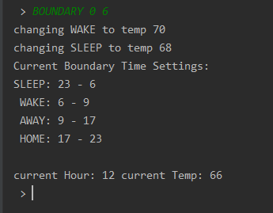
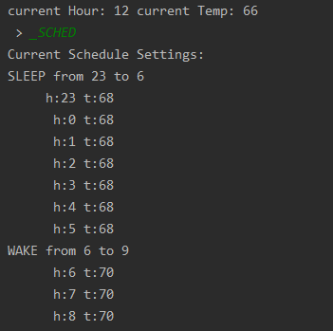
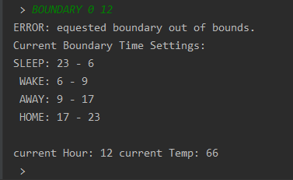
BOUNDARY command
Successful Usage
Starting from SLEEP 68, WAKE 70, AWAY 66, HOME 71 (see slide 6)
Improper Usage
Changes bound and reapplies Temps to new periods
Failed attempt to crossover beyond the next bound

Slide 10
Results and findings
Even simple applications for seemingly simple appliances can consist of complicated programming
Tokenizer and Lexer based on calclex.py using ply.lex was remarkably simple to incorporate
Parser using yacc was not, so I designed a workaround
The logic ensuring that entered commands properly adhered to grammar rules became complex quickly, even with relatively few commands, therefore
A future deep-dive and exploration of yacc would be beneficial for my further understanding
BOUNDARY changes that border a period affected by a NOW change don’t preserve the change made through NOW. This would need to be corrected.
Interactions on data state (like above) by different commands is a challenge that ideally would have been recognized and worked out in the design stage, but this interaction was overlooked

Slide 11
Results and findings, continued
As a Language Prototype only, some of the fun parts (Menu and UI Design) were not included.
This experience has nevertheless taught me a considerable amount about Programming Languages, interpreter, and compiler design.
This is just a start on my Computer Science and Software Engineering journey
I am proud of my design and prototype, and grateful for the instruction and experience

Slide 12
fin
Johnathan Picek
CPSC 46000-003
Programming Languages
Dr. Eric Chou
Lewis University
Spring 2022

